Slide 1

Magist
as a Potential Partner for High-Tech Sales in Brazil
Strategy for Eniac
Presented by:
Oleksandra Tkachenko Sanaz Arianmanesh Benno Klan

Slide 2

Magist Overview
Magist as a centralized order, logistics, and after-sales service provider that operates in Brazil with own warehouse
Market entry plan: ENIAC considers a 3-year partnership with Magist to enter Brazil
25 months of Magist data are analyzed to assess fit for ENIAC’s high-end tech and delivery needs.

Slide 3

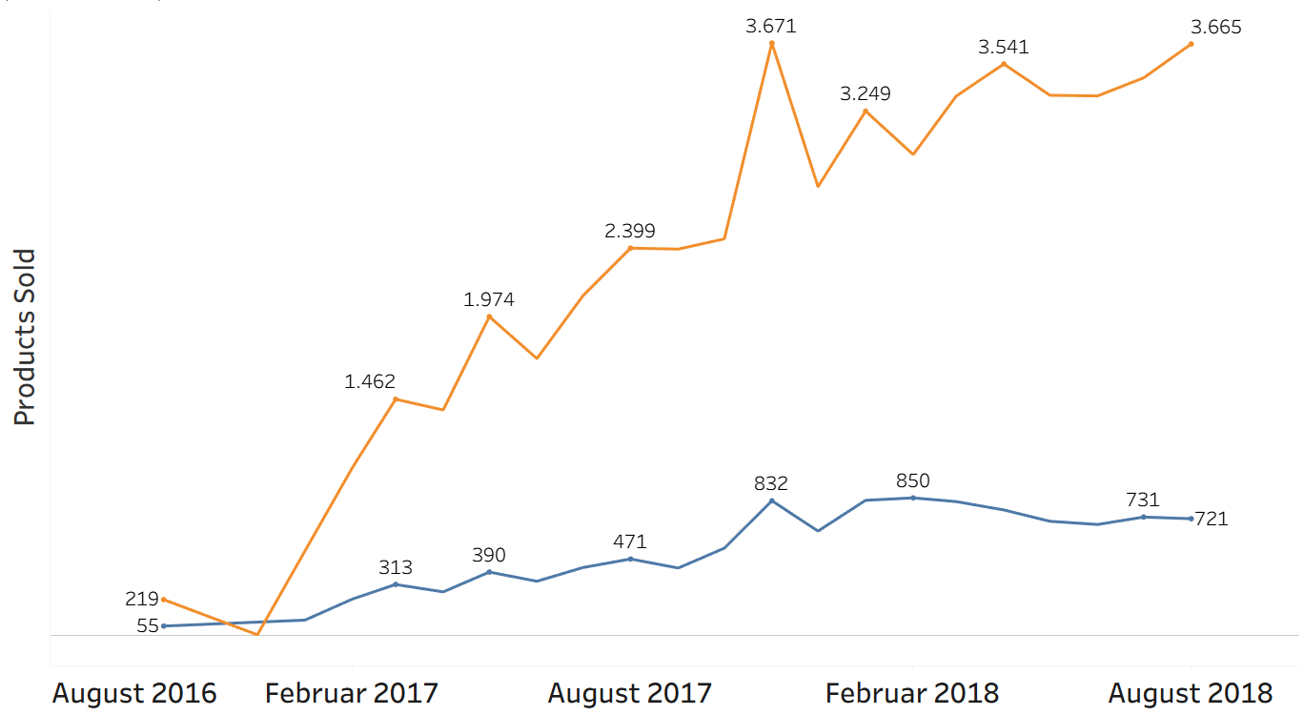
All products vs tech products

Slide 4
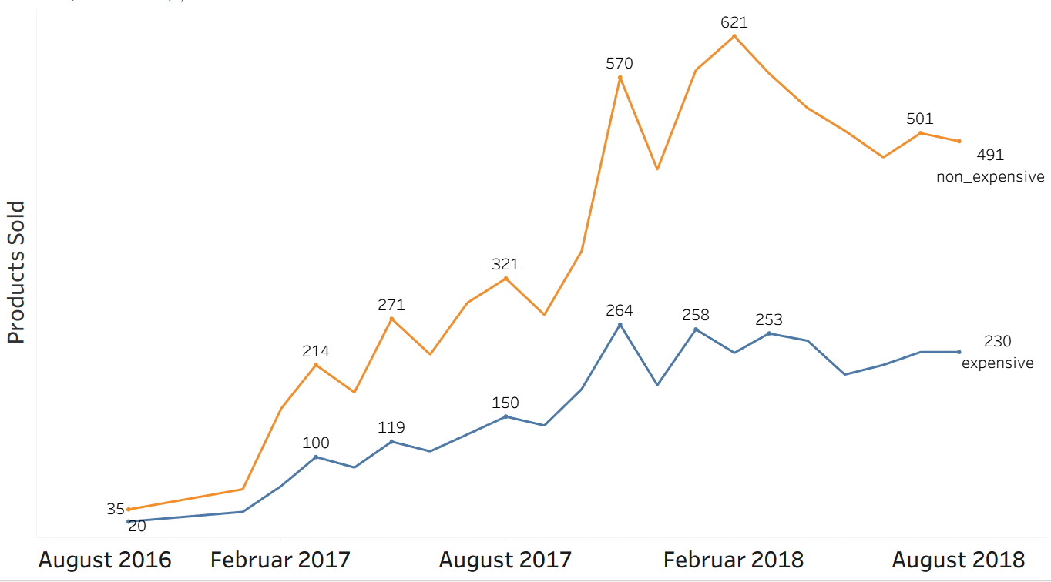
Are expensive tech products popular?
Eniac avg. Item price: 540 €
Magist avg. Item price: 121 €

Slide 5
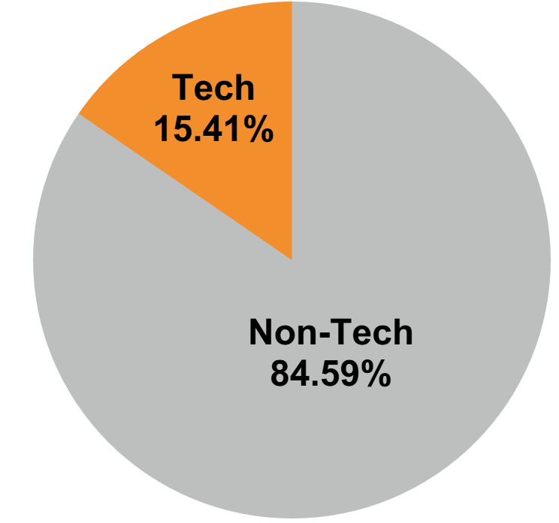
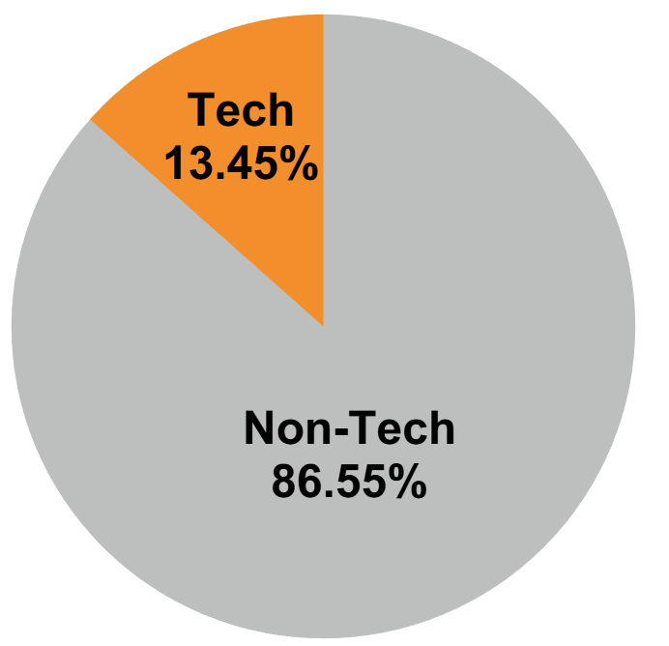
Number of Sellers:
Tech vs Non-Tech
Revenue Share:
Tech vs Non-Tech
Tech sellers play a limited role in overall revenue.
Tech sellers represent a small minority compared to non-tech sellers

Slide 6
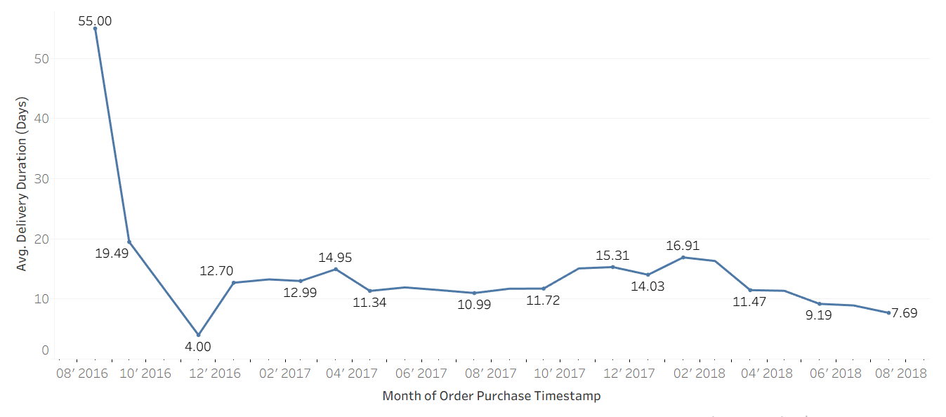
Average Time from Order Placement to Delivery
Brazil’s size results in long delivery times of about 21 days in 2020.
Average delivery time is 12 days, which improved in 2018.

Slide 7
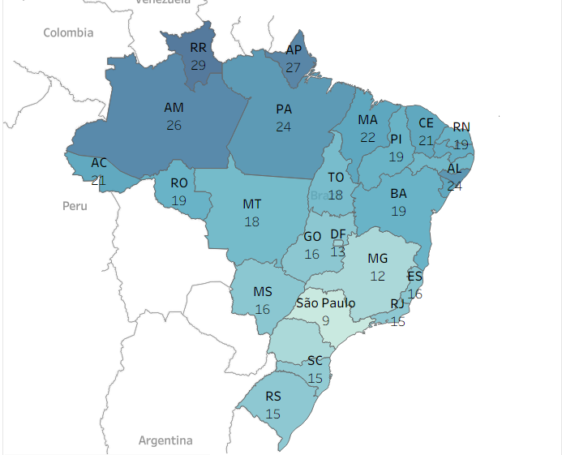
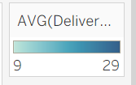
Average Delivery Time by State (Days)
Delivery times vary significantly across states, with some regions showing consistently longer delivery durations.
Delivery in São Paulo state takes 9 days.

Slide 8
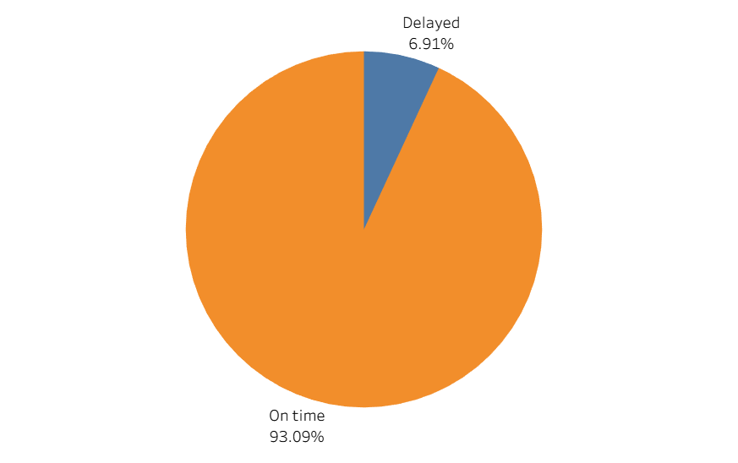
Order delivered on time vs orders delivered with a delay
Approximately 7% of delivered orders were delayed
About 93% of orders were delivered on time

Slide 9
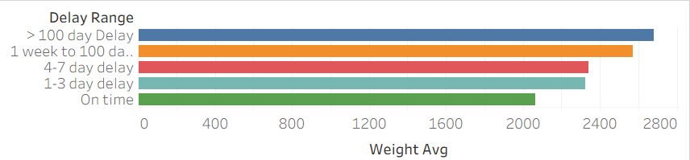
Average Weight vs Delay Range
Orders weighing up to 2 kg are delivered on time.
Notes:
Here we observe a tendency for delivery delays to increase in relation to the weight of the order.
Orders weighing up to 2 kg are delivered on time.
It suits Eniac as our focus is on high-end tech products.

Slide 10

Conclusion
✅ Magist fits to Eniac’s needs as a short-term entry partner:
Growing delivery volume
Improving delivery performance
⚠️ But not an ideal long-term partner for ENIAC’s high-end tech strategy:
Low tech focus
Delivery risk for large products

Slide 11
Thank you

Slide 12
Appendix

Slide 13
Potential Competitors
Mercado Livre (MELI):
founded in 1999
recognized as a market leader in Brazil’s online shopping ecosystem
offers same-day or next-day delivery in large metropolitan areas
such as São Paulo
remote areas within 7-15+ days by the state postal service (Correios)
logistics infrastructure expanded

